Slide 1
Exam Requirements
This is your Exam 2.
Your solution must produce the correct output and meet all the specification to be considered correct.
Additionally, it must be submitted in the correct format.
Utilize the Class diagrams and instruction provided to complete your solution.
Complete the tasks described and submit a compressed Eclipse Project.

Slide 2
Project Design
TieFighter
See Slide 5
<<Maneuvering>>
See Slide 5
<<Scanning>>
See Slide 5
TieFighter_S
See Slide 5/6
TieFighter_H
See Slide 5/6
<<Bombing>>
See Slide 5
Supporting Classes
TiePilot
See Slide 9
LaserCannon
See Slide 8
Location
See Slide 9
ProtonBomb
See Slide 8

Slide 3
Program Structure
Structure your program EXACTLY like this
Include main method here See slide 11

Slide 4
TieFighter Class
TieFighter
manufacturer: String IDNumber: String model: String wpns: TieWeapon[ ] pilot: TiePilot fighterClass: String length: double width: double height: double fuelCapacity: int maxSpeed: int isLanded: boolean isSpaceborne: boolean currentLocation: Location
TieFighter(IDNumber:String, pilot:TiePilot)
+displayFighterData(): void +abstract FiresCannons(): void
<<Maneuvering>>
+abstract MoveLeft(): void +abstract MoveRight(): void +abstract MoveForward(): void +abstract MoveBackward(): void +abstract Ascend(): void +abstract Descend(): void +abstract Land(): void +abstract Takeoff(): void
<<Scanning>>
+abstract scanTarget(): void
<<Bombing>>
+abstract bombTarget(): boolean
TieFighter_S
See Slide 6 for attribute values
TieFighter_S(IDNumber:String, pilot:TiePilot)
+FiresCannons() Implements all methods in Maneuvering and Scanning Interface
TieFighter_H
See Slide 6 for attribute values
TieFighter_H(IDNumber:String, pilot:TiePilot)
+FiresCannons() Implements all methods in Maneuvering, Scanning, and Bombing Interface

Slide 5
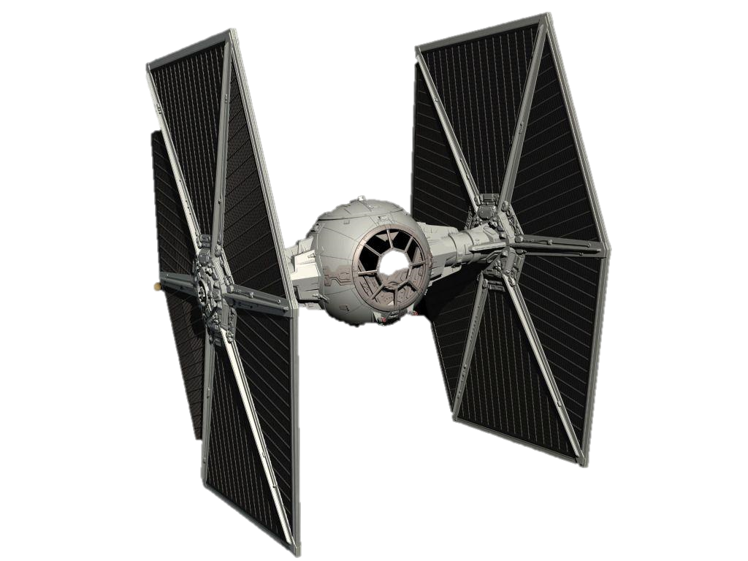
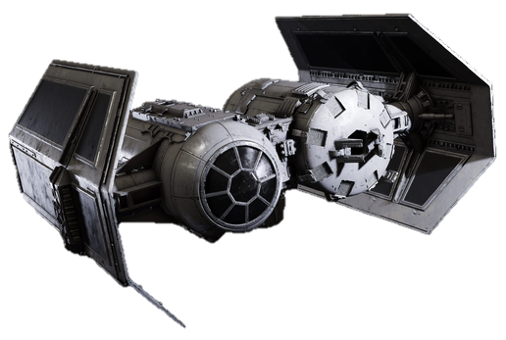
TieFighters
TieFighter_S
TieFighter_H
General Specifications
Manufacturer… Sienar Fleet Systems Model… Tie Standard FighterClass… Superiority Length… 6.3 meters Width… 6.4 meters Height… 7.5 meters FuelCapacity… 200 kilograms MaxSpeed… 1200 kilometers per hour
General Specifications
Manufacturer… Sienar Fleet Systems Model… Tie Heavy Fighter FighterClass… Close Support Length… 7.8 meters Width… 8.6 meters Height… 5.0 meters FuelCapacity… 375 kilograms MaxSpeed… 850 kilometers per hour
All TieFighters are currently located aboard the Death Star at coordinate 10,12,0
Each TieFighter_S is equipped with two laser cannons
“L1” is the model of all laser cannons assigned to TieFighter_Ss
Each TieFighter_H is equipped with two laser cannons and 8 proton bombs
“L2” is the model of all laser cannons assigned to TieFighter_Hs
“P1” is the model of all Proton Bombs assigned to TieFighter_Hs

Slide 6
TieFighter Methods
TieFighter Classes Method Specifications
Class | Method | Specification
TieFighter | displayFighterData | Prints the value of specified attributes to the console in the format shown
TieFighter_S | FiresCannons | Call the Fires method of both Laser Cannons of the TieFighter_S
TieFighter_H | FiresCannons | Call the Fires method of both Laser Cannons of the TieFighter_H

Slide 7
Supporting Classes
TieWeapon
-Model: String
+TieWeapon(Model: String)
+abstract Fire(): void
LaserCannon
-Model: String -MaxRange = 1000 -AmmoCapacity = 500 -CurrentAmmoCount: 500
+LaserCannon(Model: String)
+ Fire(): void
ProtonBomb
-Model: String -Yield = 7 -Dropped: false
+ProtonBomb(Model: String)
+Fire(): void
Supporting Classes Method Specifications
Class | Method | Specification
LaserCannon | Fire | Checks to ensure currentAmmoCount is > 0 and if so reduces currentAmmoCount by 1 and prints “Firing Cannons to the console”…otherwise prints “Ammunition Expended“ to the console
ProtonBomb | Fire | Sets the Dropped attribute to true

Slide 8
Supporting Classes
Location
-X: int -Y: int -Z: int
+Location(X:int, Y:int, Z:int)
+toString(): String
TiePilot
-IDNumber: String -Rank: String -PilotRating: String
+TiePilot(IDNumber:String, Rank:String, PilotRating:String)
+ displaysInfo(): void
Supporting Classes Method Specifications
Class | Method | Specification
Location | toString | Returns a String of the X, Y, and Z attribute values in the format shown below
TiePilot | displayInfo | Prints the values of all attributes to the console in the format shown below

Slide 9
Interface Methods
Method Name | Parameter | Return Type | Description
MoveLeft | None | void | Decreases the X component of the TieFighter currentPosition by 1
MoveRight | None | void | Increases the X component of the TieFighter currentPosition by 1
MoveForward | None | void | Increases the Y component of the TieFighter currentPosition by 1
MoveBackward | None | void | Decreases the Y component of the TieFighter currentPosition by 1
Ascend | None | void | Increases the Z component of the TieFighter currentPosition by 1
Descend | None | void | Decreases the Z component of the TieFighter currentPosition by 1
Land | None | void | Sets the Z component of the TieFighter currentPosition to 0 and sets the isLanded attribute to true and the isSpaceborne attribute to false
Takeoff | None | void | Sets the Z component of the TieFighter currentPosition to 10 and sets the isSpaceborne attribute to true and the isLanded attribute to false
Method Name | Parameter | Return Type | Description
scanTarget | None | void | Prints “[IDNumber] is scanning for targets”
Method Name | Parameter | Return Type | Description
bombTarget | None | boolean | Check to ensure that there is a ProtonBomb whose Dropped attribute equals false and if so calls the Fire method of the ProtonBomb and prints “Bombs Away” to the console and returns true…otherwise prints “Bombs Expended” to the console and returns false

Slide 10
Program Testing
Use ONLY this as your main method

